Slide 1


Information SECURITY implementation
ITE 193

Slide 2

Balancing information security & access
Even with the best planning and implementation, it is impossible to obtain perfect information security. Information security cannot be absolute: it is a process, not a goal. It is possible to make a system available to anyone, anywhere, anytime, through any means. However, such unrestricted access poses a danger to the security of the information.
On the other hand, a completely secure information system would not allow anyone access.
To achieve balance—that is, to operate an information system that satisfies the user and the security professional—the security level must allow reasonable access, yet protect against threats.

Slide 3
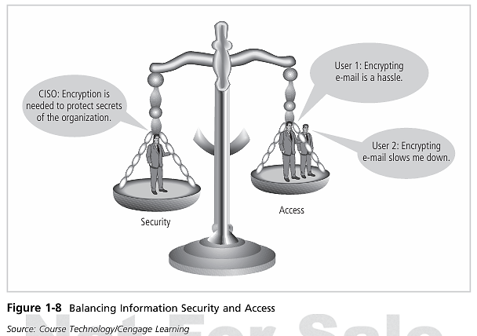
Balancing information security & access
Notes:
*CISO – Chief InfoSec Officer

Slide 4
Balancing information security & access
Because of today’s security concerns and issues, an information system or data-processing department can get too entrenched in the management and protection of systems. An imbalance can occur when the needs of the end user are undermined by too heavy a focus on protecting and administering the information systems. Both information security technologists and end users must recognize that both groups share the same overall goals of the organization—to ensure the data is available when, where, and how it is needed, with minimal delays or obstacles.
In an ideal world, this level of availability can be met even after concerns about loss, damage, interception, or destruction have been addressed.

Slide 5
Approaches TO infosec implementation
The implementation of information security in an organization must begin somewhere, and cannot happen overnight.
Securing information assets is in fact an incremental process that requires coordination, time, and patience.

Slide 6
Approaches TO infosec implementation: bottom-up approach
Information security can begin as a grassroots effort in which systems administrators attempt to improve the security of their systems. This is often referred to as a bottom-up approach.
The key advantage of the bottom-up approach is the technical expertise of the individual administrators. Working with information systems on a day-to-day basis, these administrators possess in-depth knowledge that can greatly enhance the development of an InfoSec system. They know and understand the threats to their systems and the mechanisms needed to protect them successfully.
Unfortunately, this approach seldom works, as it lacks a number of critical features, such as participant support and organizational staying power.
Notes:
The system administrator seeks to ensure that the uptime, performance, resources, and security of the computers they manage meet the needs of the users, without exceeding a set budget when doing so.

Slide 7
Approaches TO infosec implementation: TOP-DOWN approach
The top-down approach—in which the project is initiated by upper-level managers who issue policy, procedures and processes, dictate the goals and expected outcomes, and determine accountability for each required action—has a higher probability of success.
This approach has strong upper-management support, a dedicated champion, usually dedicated funding, a clear planning and implementation process, and the means of influencing organizational culture. The most successful kind of top-down approach also involves a formal development strategy referred to as a systems development life cycle.

Slide 8
Approaches TO infosec implementation
For any organization-wide effort to succeed, management must buy into and fully support it. The role played in this effort by the champion cannot be overstated. Typically, this champion is an executive, such as a chief information officer (CIO) or the vice president of information technology (VP-IT), who moves the project forward, ensures that it is properly managed, and pushes for acceptance throughout the organization. Without this high-level support, many mid-level administrators fail to make time for the project or dismiss it as a low priority.

Slide 9
Approaches TO infosec implementation
Also critical to the success of this type of project is the involvement and support of the end users. These individuals are most directly affected by the process and outcome of the project and must be included in the information security process.
Key end users should be assigned to a developmental team, known as the Joint Application Development (JAD) team. To succeed, the JAD must have staying power. It must be able to survive employee turn over and should not be vulnerable to changes in the personnel team that is developing the information security system. This means the processes and procedures must be documented and integrated into the organizational culture. They must be adopted and promoted by the organization’s management.
Notes:
Joint application development, frequently shortened to JAD, is a methodology that involves the client or end user in the design and development of a software application through a succession of collaborative workshops called JAD sessions

Slide 10
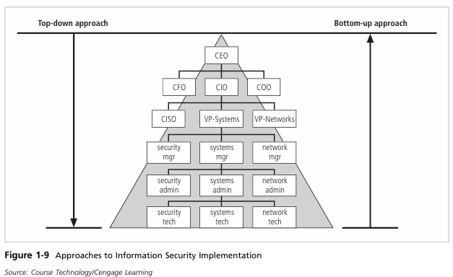
Notes:
CFO – Chief Financial Officer
COO – Chief Operations Officer

Slide 11
The systems development life cycle (SDLC)
Information security must be managed in a manner similar to any other major system implemented in an organization. One approach for implementing an information security system in an organization with little or no formal security in place is to use a variation of the systems development life cycle (SDLC): the security systems development life cycle (SecSDLC).
To understand a security systems development life cycle, you must first understand the basics of the method upon which it is based.

Slide 12
Methodology and phases
The systems development life cycle (SDLC) is a methodology for the design and implementation of an information system.
A methodology is a formal approach to solving a problem by means of a structured sequence of procedures. Using a methodology ensures a rigorous process with a clearly defined goal and increases the probability of success. Once a methodology has been adopted, the key milestones are established and a team of individuals is selected and made accountable for accomplishing the project goals.

Slide 13
Methodology and phases
The traditional SDLC consists of six general phases. If you have taken a system analysis and design course, you may have been exposed to a model consisting of a different number of phases. SDLC models range from having three to twelve phases, all of which have been mapped into the six presented here.
The waterfall model pictured in Figure 1-10 illustrates that each phase begins with the results and information gained from the previous phase.

Slide 14
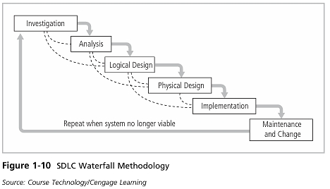
Methodology and phases: the Waterfall model

Slide 15
Waterfall model: investigation
The first phase, investigation, is the most important. What problem is the system being developed to solve? The investigation phase begins with an examination of the event or plan that initiates the process. During the investigation phase, the objectives, constraints, and scope of the project are specified. A preliminary cost-benefit analysis evaluates the perceived benefits and the appropriate levels of cost for those benefits. At the conclusion of this phase, and at every phase following, a feasibility analysis assesses the economic, technical, and behavioral feasibilities of the process and ensures that implementation is worth the organization’s time and effort.

Slide 16
Waterfall model: ANALYSIS
The analysis phase begins with the information gained during the investigation phase. This phase consists primarily of assessments of the organization, its current systems, and its capability to support the proposed systems. Analysts begin by determining what the new system is expected to do and how it will interact with existing systems. This phase ends with the documentation of the findings and an update of the feasibility analysis.

Slide 17
Waterfall model: LOGICAL DESIGN
In the logical design phase, the information gained from the analysis phase is used to begin creating a systems solution for a business problem. In any systems solution, it is imperative that the first and driving factor is the business need. Based on the business need, applications are selected to provide needed services, and then data support and structures capable of providing the needed inputs are chosen. Finally, based on all of the above, specific technologies to implement the physical solution are determined.
The logical design is, therefore, the blue print for the desired solution. The logical design is implementation independent, meaning that it contains no reference to specific technologies, vendors, or products. It addresses, instead, how the proposed system will solve the problem at hand.

Slide 18
Waterfall model: LOGICAL DESIGN
In this stage, analysts generate a number of alternative solutions, each with corresponding strengths and weaknesses, and costs and benefits, allowing for a general comparison of available options. At the end of this phase, another feasibility analysis is performed.

Slide 19
Waterfall model: Physical DESIGN
During the physical design phase, specific technologies are selected to support the alternatives identified and evaluated in the logical design. The selected components are evaluated based on a make-or-buy decision (develop the components in-house or purchase them from a vendor). Final designs integrate various components and technologies. After yet another feasibility analysis, the entire solution is presented to the organizational management for approval.

Slide 20
Waterfall model: Implementation
In the implementation phase, any needed software is created. Components are ordered, received, and tested. Afterward, users are trained and supporting documentation created. Once all components are tested individually, they are installed and tested as a system. Again a feasibility analysis is prepared, and the sponsors are then presented with the system for a performance review and acceptance test.

Slide 21
Waterfall model: Maintenance & change
The maintenance and change phase is the longest and most expensive phase of the process. This phase consists of the tasks necessary to support and modify the system for the remainder of its useful life cycle. Even though formal development may conclude during this phase, the life cycle of the project continues until it is determined that the process should begin again from the investigation phase. At periodic points, the system is tested for compliance, and the feasibility of continuance versus discontinuance is evaluated. Upgrades, updates, and patches are managed.

Slide 22
Waterfall model: Maintenance & change
As the needs of the organization change, the systems that support the organization must also change. It is imperative that those who manage the systems, as well as those who support them, continually monitor the effectiveness of the systems in relation to the organization’s environment. When a current system can no longer support the evolving mission of the organization, the project is terminated and a new project is implemented.

Slide 23
Securing the SDLC
Each of the phases of the SDLC should include consideration of the security of the system being assembled as well as the information it uses. Whether the system is custom and built from scratch, is purchased and then customized, or is commercial off-the-shelf software (COTS), the implementing organization is responsible for ensuring it is used securely. This means that each implementation of a system is secure and does not risk compromising the confidentiality, integrity, and availability of the organization’s information assets.
Notes:
Commercial Off-the-Shelf Software (COTS) is mass produced software accessible by everyone. Such software caters to the everyday needs of the masses and ranges from anti-virus programs, word processors, and database development applications to spreadsheets and much more.

Slide 24
Securing the SDLC
The following section, adapted from NIST Special Publication 800-64, rev. 1, provides an overview of the security considerations for each phase of the SDLC.
Each of the example SDLC phases includes a minimum set of security steps needed to effectively incorporate security into a system during its development. An organization will either use the general SDLC described or will have developed a tailored SDLC that meets their specific needs. In either case, NIST recommends that organizations incorporate the associated IT security steps of this general SDLC into their development process:
Notes:
NIST is the National Institute of Standards and Technology at the U.S. Department of Commerce.

Slide 25
Securing the SDLC Waterfall: investigation/Analysis Phase
Security categorization—defines three levels (i.e., low, moderate, or high) of potential impact on organizations or individuals should there be a breach of security (a loss of confidentiality, integrity, or availability). Security categorization standards assist organizations in making the appropriate selection of security controls for their information systems.
Preliminary risk assessment—results in an initial description of the basic security needs of the system. A preliminary risk assessment should define the threat environment in which the system will operate.

Slide 26
Securing the SDLC Waterfall: Logical/Physical Design Phases
Risk assessment—analysis that identifies the protection requirements for the system through a formal risk assessment process. This analysis builds on the initial risk assessment performed during the Initiation phase, but will be more in-depth and specific.
Security functional requirements analysis—analysis of requirements that may include the following components: (1) system security environment (i.e., enterprise information security policy and enterprise security architecture) and (2) security functional requirements

Slide 27
Securing the SDLC Waterfall: Logical/Physical Design Phases
Security assurance requirements analysis—analysis of requirements that address the developmental activities required and assurance evidence needed to produce the desired level of confidence that the information security will work correctly and effectively. The analysis, based on legal and functional security requirements, will be used as the basis for determining how much and what kinds of assurance are required.
Cost considerations and reporting—determines how much of the development cost can be attributed to information security over the life cycle of the system. These costs include hardware, software, personnel, and training.

Slide 28
Securing the SDLC Waterfall: Logical/Physical Design Phases
Security planning—ensures that agreed upon security controls, planned or in place, are fully documented. The security plan also provides a complete characterization or description of the information system as well as attachments or references to key documents supporting the agency’s information security pro gram (e.g., configuration management plan, contingency plan, incident response plan, security awareness and training plan, rules of behavior, risk assessment, security test and evaluation results, system interconnection agreements, security authorizations/ accreditations, and plan of action and milestones).

Slide 29
Securing the SDLC Waterfall: Logical/Physical Design Phases
Security control development—ensures that security controls described in the respective security plans are designed, developed, and implemented. For information systems currently in operation, the security plans for those systems may call for the development of additional security controls to supplement the controls already in place or the modification of selected controls that are deemed to be less than effective.

Slide 30
Securing the SDLC Waterfall: Logical/Physical Design Phases
Developmental security test and evaluation—ensures that security controls developed for a new information system are working properly and are effective. Some types of security controls (primarily those controls of a non-technical nature) cannot be tested and evaluated until the information system is deployed—these controls are typically management and operational controls.
Other planning components—ensures that all necessary components of the development process are considered when incorporating security into the life cycle. These components include selection of the appropriate contract type, participation by all necessary functional groups within an organization, participation by the certifier and accreditor, and development and execution of necessary contracting plans and processes.

Slide 31
Securing the SDLC Waterfall: IMPLEMENTATION Phases
Inspection and acceptance—ensures that the organization validates and verifies that the functionality described in the specification is included in the deliverables.
System integration—ensures that the system is integrated at the operational site where the information system is to be deployed for operation. Security control settings and switches are enabled in accordance with vendor instructions and available security implementation guidance.

Slide 32
Securing the SDLC Waterfall: IMPLEMENTATION Phases
Security certification—ensures that the controls are effectively implemented through established verification techniques and procedures and gives organization officials confidence that the appropriate safeguards and countermeasures are in place to protect the organization’s information system. Security certification also uncovers and describes the known vulnerabilities in the information system.

Slide 33
Securing the SDLC Waterfall: IMPLEMENTATION Phases
Security accreditation—provides the necessary security authorization of an information system to process, store, or transmit information that is required. This authorization is granted by a senior organization official and is based on the verified effectiveness of security controls to some agreed upon level of assurance and an identified residual risk to agency assets or operations.

Slide 34
Securing the SDLC Waterfall: MAINTENANCE & change Phase
Configuration management and control—ensures adequate consideration of the potential security impacts due to specific changes to an information system or its surrounding environment. Configuration management and configuration control procedures are critical to establishing an initial baseline of hardware, software, and firmware components for the information system and subsequently controlling and maintaining an accurate inventory of any changes to the system.

Slide 35
Securing the SDLC Waterfall: MAINTENANCE & change Phase
Continuous monitoring—ensures that controls continue to be effective in their application through periodic testing and evaluation. Security control monitoring (i.e., verifying the continued effectiveness of those controls over time) and reporting the security status of the information system to appropriate agency officials is an essential activity of a comprehensive information security program.

Slide 36
Securing the SDLC Waterfall: MAINTENANCE & change Phase
Information preservation—ensures that information is retained, as necessary, to conform to current legal requirements and to accommodate future technology changes that may render the retrieval method obsolete.
Media sanitization—ensures that data is deleted, erased, and written over as necessary.
Hardware and software disposal—ensures that hardware and software is dis posed of as directed by the information system security officer.
*Adapted from Security Considerations in the Information System Development Life Cycle.

Slide 37
Securing the SDLC: Waterfall MODEL
It is imperative that information security be designed into a system from its inception, rather than added in during or after the implementation phase. Information systems that were designed with no security functionality, or with security functions added as an afterthought, often require constant patching, updating, and maintenance to prevent risk to the systems and information.
It is a well-known adage that “an ounce of prevention is worth a pound of cure.” With this in mind, organizations are moving toward more security-focused development approaches, seeking to improve not only the functionality of the systems they have in place, but consumer confidence in their products.

Slide 38
security systems development life cycle
INVESTIGATION
a directive from upper management, dictating the process, outcomes, and goals of the project, as well as its budget and other constraints. Frequently, this phase begins with an enterprise information security policy (EISP), which outlines the implementation of a security program within the organization. Teams of responsible managers, employees, and contractors are organized; problems are analyzed; and the scope of the project, as well as specific goals and objectives and any additional constraints not covered in the program policy, are defined.
an organizational feasibility analysis is performed to determine whether the organization has the resources and commitment necessary to conduct a successful security analysis and design.

Slide 39
security systems development life cycle
ANALYSIS
the documents from the investigation phase are studied. The development team conducts a preliminary analysis of existing security policies or programs, along with that of documented current threats and associated controls. This phase also includes an analysis of relevant legal issues that could affect the design of the security solution. Increasingly, privacy laws have become a major consideration when making decisions about information systems that manage personal information.
Risk management also begins in this stage. Risk management is the process of identifying, assessing, and evaluating the levels of risk facing the organization, specifically the threats to the organization’s security and to the information stored and processed by the organization.

Slide 40
security systems development life cycle
LOGICAL DESIGN
The logical design phase creates and develops the blueprints for information security, and examines and implements key policies that influence later decisions. Also at this stage, the team plans the incident response actions to be taken in the event of partial or catastrophic loss. The planning answers the following questions:
Continuity planning: How will business continue in the event of a loss?
Incident response: What steps are taken when an attack occurs?
Disaster recovery: What must be done to recover information and vital systems immediately after a disastrous event?
Next, a feasibility analysis determines whether or not the project should be continued or be outsourced.

Slide 41
security systems development life cycle
PHYSICAL DESIGN
The physical design phase evaluates the information security technology needed to support the blueprint outlined in the logical design generates alternative solutions, and determines a final design. The information security blueprint may be revisited to keep it in line with the changes needed when the physical design is completed.
Criteria for determining the definition of successful solutions are also prepared during this phase. Included at this time are the designs for physical security measures to support the proposed technological solutions. At the end of this phase, a feasibility study determines the readiness of the organization for the proposed project, and then the champion and sponsors are presented with the design. At this time, all parties involved have a chance to approve the project before implementation begins.

Slide 42
security systems development life cycle
IMPLEMENTATION
The implementation phase in of SecSDLC is also similar to that of the traditional SDLC. The security solutions are acquired (made or bought), tested, implemented, and tested again. Personnel issues are evaluated, and specific training and education programs conducted. Finally, the entire tested package is presented to upper management for final approval.

Slide 43
security systems development life cycle
MAINTENANCE and CHECK
This is the last, though perhaps most important, phase, given the current ever-changing threat environment. Today’s InfoSec systems need constant monitoring, testing, modification, updating, and repairing. Applications systems developed within the framework of the traditional SDLC are not designed to anticipate a software attack that requires some degree of application reconstruction.
In InfoSec, the battle for stable, reliable systems is a defensive one. Often, repairing damage & restoring information is a constant effort against an unseen adversary. As new threats emerge and old threats evolve, the information security profile of an organization must constantly adapt to prevent threats from successfully penetrating sensitive data.
Notes:
This constant vigilance and security can be compared to that of a fortress where threats from outside as well as from within must be constantly monitored and checked with continuously new and more innovative technologies.

Slide 44
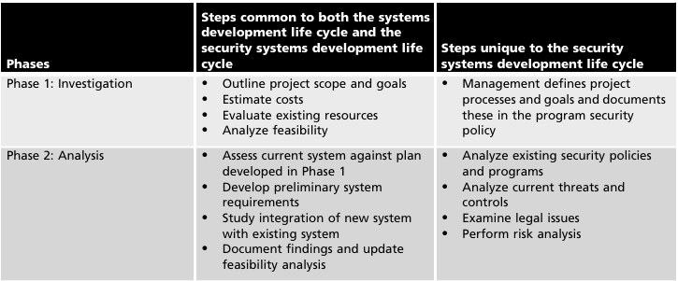
SDLC and SecSDLC Phase Summary

Slide 45
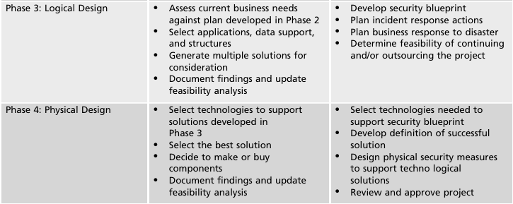
SDLC and SecSDLC Phase Summary

Slide 46
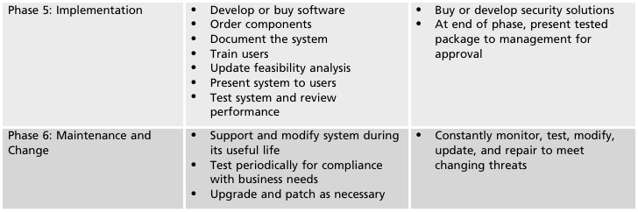
SDLC and SecSDLC Phase Summary

Slide 47
TO BE CONTINUED.
Reference:
Introduction to Information Security [NIST]

